Slide 1
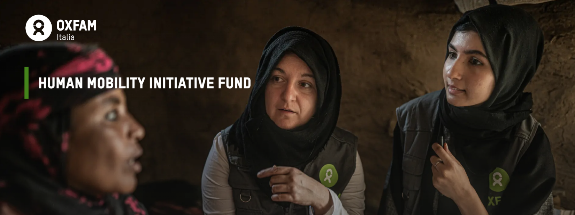
INFO SESSION
8 February 2024

Slide 2
GUIDELINES
FOR APPLICANTS
Info session
OXFAM
Oxfam
What is the Human Mobility Initiative?
HMI Fund: the Call for Applications
Which activities do we prioritize?
Eligibility Criteria
Grant
Timeline

Slide 3
ABOUT OXFAM
Oxfam works in 90 countries across the world, and with thousands of partners and allies.
We support communities to build better lives for themselves, grow resilience and protect lives and livelihoods in times of crisis. We fight the inequalities that keep people locked in poverty and injustice. We tackle not the symptoms but the systems, and we campaign for genuine, long-lasting change.
WHO WE ARE
WE FIGHT FOR A MORE EQUAL FUTURE
Oxfam fights inequality to end poverty and injustice.
We are part of a global movement, campaigning for economic, gender and climate justice – for change that lasts. Together, we can forge an equal future, with equal rights and equal opportunities, so that every one of us can thrive, not just survive.
OUR VALUES
EQUALITY - We believe that everyone has the right to be treated fairly and to have the same rights and opportunities.
EMPOWERMENT - We acknowledge and seek to expand people’s agency over their lives and the decisions that impact them.
SOLIDARITY - We join hands, support and collaborate across boundaries in working towards a just and sustainable world
INCLUSIVENESS - We embrace diversity and difference and value the perspectives and contributions of all people and communities in their fight against poverty and injustice.
ACCOUNTABILITY - We take responsibility for our action and inaction and hold ourselves accountable to the people we work with and for.
COURAGE - We speak truth to power and act with conviction on the justice of our causes.
GUIDELINES
FOR APPLICANTS
Info session
Oxfam
What is the Human Mobility Initiative?
HMI Fund: the Call for Applications
Which activities do we prioritize?
Eligibility Criteria
Grant
Timeline

Slide 4
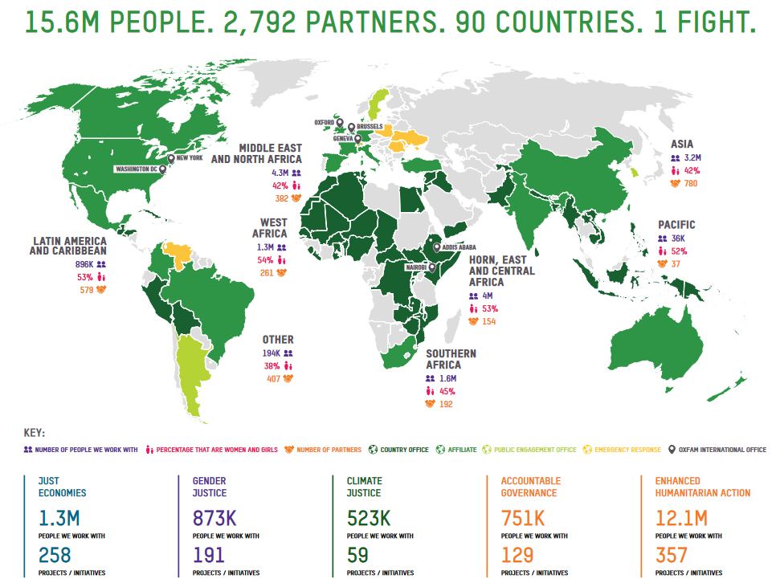
GUIDELINES
FOR APPLICANTS
Info session
Oxfam
What is the Human Mobility Initiative?
HMI Fund: the Call for Applications
Which activities do we prioritize?
Eligibility Criteria
Grant
Timeline

Slide 5
GUIDELINES
FOR APPLICANTS
Info session
OXFAM
Oxfam
What is the Human Mobility Initiative?
HMI Fund: the Call for Applications
Which activities do we prioritize?
Eligibility Criteria
Grant
Timeline

Slide 6
GUIDELINES
FOR APPLICANTS
Info session
OXFAM
What is the Human Mobility Initiative?
Oxfam
What is the Human Mobility Initiative?
HMI Fund: the Call for Applications
Which activities do we prioritize?
Eligibility Criteria
Grant
Timeline

Slide 7
What is the Human Mobility Initiative?
GUIDELINES
FOR APPLICANTS
Info session
Oxfam has established the Human Mobility Initiative (HMI), aiming to
influence
national, regional and international policies on migration.
Oxfam
What is the Human Mobility Initiative?
HMI Fund: the Call for Applications
Which activities do we prioritize?
Eligibility Criteria
Grant
Timeline
The main objective
of the HMI
is to make a more welcoming world which recognizes that
migration is
a natural and positive phenomenon
that can be managed humanely
and, in a right,
respecting way.
Within this initiative, Oxfam has set up the Human Mobility Initiative Fund (HMIF), a fund providing grants to local organizations.

Slide 8
GUIDELINES
FOR APPLICANTS
Info session
OXFAM
What is the Human Mobility Initiative?
Oxfam
What is the Human Mobility Initiative?
HMI Fund: the Call for Applications
Which activities do we prioritize?
Eligibility Criteria
Grant
Timeline

Slide 9
GUIDELINES
FOR APPLICANTS
Info session
OXFAM
What is the Human Mobility Initiative?
Oxfam
What is the Human Mobility Initiative?
HMI Fund: the Call for Applications
Which activities do we prioritize?
Eligibility Criteria
Grant
Timeline
HMI Fund: the Call for Applications

Slide 10
HMI Fund: the Call for Applications
Objectives
GUIDELINES
FOR APPLICANTS
Info session
The general objective of the HMI-Fund’s Call for Applications is to support migrants/refugees-led organizations and front-line migrants/refugees’ rights organizations in their work on influencing and jointly advancing a transformative migration policy agenda.
Oxfam
What is the Human Mobility Initiative?
HMI Fund: the Call for Applications
Which activities do we prioritize?
Eligibility Criteria
Grant
Timeline
SPECIFIC OBJECTIVES OF THE CALL:
Ensuring that migrants and refugees’ rights are respected, and they have access to local and sustainable solutions respecting their rights and dignity, reducing potential conflict with hosting communities.
Promoting the deliberate and systematic inclusion of the perspectives, needs and recommendations of local refugee, migrant, front-line and migrant/refugee women’s rights organizations into policymaking.

Slide 11
HMI Fund: the Call for Applications
Which organizations do we prioritize?
GUIDELINES
FOR APPLICANTS
Info session
Refugee and migrant-led organizations
Front-line organizations operating along borders, transition centres and places of arrivals of refugees and migrants
Oxfam
What is the Human Mobility Initiative?
HMI Fund: the Call for Applications
Which activities do we prioritize?
Eligibility Criteria
Grant
Timeline
Migrants and refugees' rights organizations
GEOGRAPHICAL SCOPE:
This is a global call
However, countries where Oxfam has an operational office and/or program will be prioritized.​
https://www.oxfam.org.uk/about-us/where-we-work/.​

Slide 12
HMI Fund: the Call for Applications
… other info
GUIDELINES
FOR APPLICANTS
Info session
Deadline for submission 22/02!
Project duration: between
6 and 9 months
Oxfam
What is the Human Mobility Initiative?
HMI Fund: the Call for Applications
Which activities do we prioritize?
Eligibility Criteria
Grant
Timeline
Fill the application form in English
FAQ will be published on the website on 12/02

Slide 13
GUIDELINES
FOR APPLICANTS
Info session
OXFAM
What is the Human Mobility Initiative?
Oxfam
What is the Human Mobility Initiative?
HMI Fund: the Call for Applications
Which activities do we prioritize?
Eligibility Criteria
Grant
Timeline
HMI Fund: the Call for Applications

Slide 14
GUIDELINES
FOR APPLICANTS
Info session
OXFAM
What is the Human Mobility Initiative?
Oxfam
What is the Human Mobility Initiative?
HMI Fund: the Call for Applications
Which activities do we prioritize?
Eligibility Criteria
Grant
Timeline
HMI Fund: the Call for Applications
Which activities do we prioritize?

Slide 15
Which activities do we prioritize?
GUIDELINES
FOR APPLICANTS
Info session
Evidence-based research
and/or
data collection and analysis
Migrants and refugees’ rights advocacy and campaigns.
EXAMPLES OF RESEARCH AND ADVOCACY:
The multiple drivers of human mobility
Legal status & rights of migrants and refugees​​
Pushbacks​​: denial of the right to cross a border to seek asylum
Externalization of migration policies and impact of such policies on migrants/ refugees/ host countries and host communities.​​
​​
Challenges faced by women and girls and vulnerable groups migrants or refugees, and policies to address these challenges​​
Addressing discrimination, xenophobia, and racism
Social cohesion and harmony (challenges and/or best practices)​
Oxfam
What is the Human Mobility Initiative?
HMI Fund: the Call for Applications
Which activities do we prioritize?
Eligibility Criteria
Grant
Timeline

Slide 16
GUIDELINES
FOR APPLICANTS
Info session
OXFAM
What is the Human Mobility Initiative?
Oxfam
What is the Human Mobility Initiative?
HMI Fund: the Call for Applications
Which activities do we prioritize?
Eligibility Criteria
Grant
Timeline
HMI Fund: the Call for Applications
Which activities do we prioritize?

Slide 17
GUIDELINES
FOR APPLICANTS
Info session
OXFAM
What is the Human Mobility Initiative?
Oxfam
What is the Human Mobility Initiative?
HMI Fund: the Call for Applications
Which activities do we prioritize?
Eligibility Criteria
Grant
Timeline
HMI Fund: the Call for Applications
Eligibility Criteria
Which activities do we prioritize?

Slide 18
ELIGIBILITY CRITERIA
* A non-profit organization is defined as any organization not driven by profit, but by dedication to a specific cause that is the goal of all income beyond that necessary for the operation of the organization. This includes: associations, cooperatives, universities and research centers, and limited liability companies with a nonprofit mission.
GUIDELINES
FOR APPLICANTS
Info session
1
Non-profit nature
YES
ELIGIBLE
Are you a non-profit organization*?
NOT ELIGIBLE
NO
Oxfam
What is the Human Mobility Initiative?
HMI Fund: the Call for Applications
Which activities do we prioritize?
Eligibility Criteria
Grant
Timeline
2
Non-political nature
NO
ELIGIBLE
Are you a political party or supporting political party organization?
NOT ELIGIBLE
YES
3
Valid registration
YES
ELIGIBLE
My organization is in the process of renewing our registration
Are you registered in at least one of the countries
where you are planning to implement the activities
of your project?
My organization is in the process of getting registered
ELIGIBLE
NO, BUT…
My organization does not intend to register because it would not be able to fully operate and would be at risk
NO
NOT ELIGIBLE

Slide 19
ELIGIBILITY CRITERIA
GUIDELINES
FOR APPLICANTS
Info session
4
Bank Account
YES
ELIGIBLE
Oxfam
What is the Human Mobility Initiative?
HMI Fund: the Call for Applications
Which activities do we prioritize?
Eligibility Criteria
Grant
Timeline
If selected, will you be able to indicate a current bank account in the organization’s name?
My organization can provide a bank account in the name of one or more of the board members
ELIGIBLE
NO, BUT…
NO
NOT ELIGIBLE
5
Prior relevant experience
YES
ELIGIBLE
Do you have at least one year of experience in implementing activities related to migrant/refugee rights?
NO
NOT ELIGIBLE

Slide 20
ELIGIBILITY CRITERIA
GUIDELINES
FOR APPLICANTS
Info session
6
Tax and social legislation compliance
YES
ELIGIBLE
Does your organization comply with the requirements of applicable tax and social legislation in the country/ies where you operate?
Oxfam
What is the Human Mobility Initiative?
HMI Fund: the Call for Applications
Which activities do we prioritize?
Eligibility Criteria
Grant
Timeline
NO
NOT ELIGIBLE
7
Involvement in harmful activities
8
Prevention of sexual exploitation and abuse
Can you confirm that your organization is NOT involved in any harmful activites, such as arms dealing or industries related to tobacco, alcohol and gambling?
Can you confirm that your organization IS taking all necessary measures to prevent sexual exploitation and abuse?
YES
NO
YES
NO
ELIGIBLE
NOT ELIGIBLE
ELIGIBLE
NOT ELIGIBLE

Slide 21
GUIDELINES
FOR APPLICANTS
Info session
OXFAM
What is the Human Mobility Initiative?
Oxfam
What is the Human Mobility Initiative?
HMI Fund: the Call for Applications
Which activities do we prioritize?
Eligibility Criteria
Grant
Timeline
HMI Fund: the Call for Applications
Eligibility Criteria
Which activities do we prioritize?

Slide 22
GUIDELINES
FOR APPLICANTS
Info session
OXFAM
What is the Human Mobility Initiative?
Grant
Oxfam
What is the Human Mobility Initiative?
HMI Fund: the Call for Applications
Which activities do we prioritize?
Eligibility Criteria
Grant
Timeline
HMI Fund: the Call for Applications
Eligibility Criteria
Which activities do we prioritize?

Slide 23
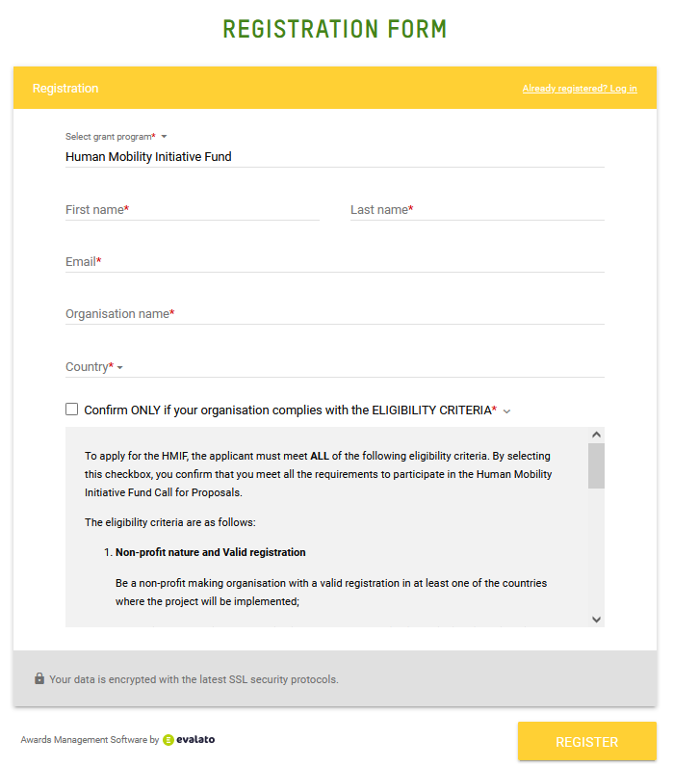
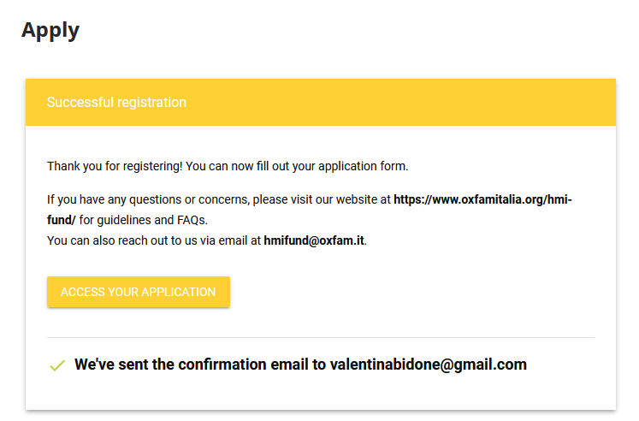
Grant - Application form
GUIDELINES
FOR APPLICANTS
Info session
Oxfam
What is the Human Mobility Initiative?
HMI Fund: the Call for Applications
Which activities do we prioritize?
Eligibility Criteria
Grant
Timeline
link

Slide 24
Grant - Budget
GUIDELINES
FOR APPLICANTS
Info session
Each organization can apply for a minimum of 20,000 and a maximum of 30,000 Euro.
Oxfam will consider proposal below the 20,000 Euro
The total budget we have available for now is 170,000 Euro and we calculate to fund around 7-8 proposals
Oxfam
What is the Human Mobility Initiative?
HMI Fund: the Call for Applications
Which activities do we prioritize?
Eligibility Criteria
Grant
Timeline
(A)Human Resources | No limits
(B) Program implementation costs* *Costs related to the activities proposed but also workshops, meetings, travel costs etc. | No limits
(C) Communication | No limits
(D) Operational costs* *Administrative, office and equipment costs | Maximum 30% of total contribution requested
Total financial contribution (min 20,000 – max 30,000 euros) | = (A)+(B)+(C)+(D)
The sum of the different cost items under categories (A), (B), (C), (D) must be equal to the total financial contribution you are requesting.
Projects must be implemented directly by the applicant. The grant may not be transferred to other entities.
Examples of cost NOT eligible: | Examples of cost ELIGIBLE:
Cash donation Costs declared and already financed by other funds Scholarships, sponsorships, and school fees Costs declared and already financed by other funds Purchases of land or buildings Debts and debt service charges (interest) Etc. | Media campaign Enumerators fees Translation and interpreters Office rental Travel costs Etc.

Slide 25
GUIDELINES
FOR APPLICANTS
Info session
OXFAM
What is the Human Mobility Initiative?
Grant
Oxfam
What is the Human Mobility Initiative?
HMI Fund: the Call for Applications
Which activities do we prioritize?
Eligibility Criteria
Grant
Timeline
HMI Fund: the Call for Applications
Eligibility Criteria
Which activities do we prioritize?

Slide 26
GUIDELINES
FOR APPLICANTS
Info session
OXFAM
What is the Human Mobility Initiative?
Timeline
Grant
Oxfam
What is the Human Mobility Initiative?
HMI Fund: the Call for Applications
Which activities do we prioritize?
Eligibility Criteria
Grant
Timeline
...
HMI Fund: the Call for Applications
Eligibility Criteria
...
Which activities do we prioritize?

Slide 27
Timeline:
GUIDELINES
FOR APPLICANTS
Info session
Publication of the ranking list of winning proposals and information to eligible applicants.
Start date of the project/initiative implementation
Oxfam
What is the Human Mobility Initiative?
HMI Fund: the Call for Applications
Which activities do we prioritize?
Eligibility Criteria
Grant
Timeline
From 15/03/24
To
01/04/24
01/03/24
15/03/24
01/04/24
Information to applicants about the outcome of the eligibility criteria evaluation of their proposal
Due diligence: check of all the documentation and sign of the grant contract with Oxfam
Under section 11. Evaluation and Selection process, on the Guidance for applicants, you can find the evaluation grid, indicating how your proposal will be scored from our evaluation committee

Slide 29
Valentina Bidone and Sabrina Falini
hmifund@oxfam.it
https://www.oxfamitalia.org/hmi-fund/.

